Slide 1

Adani-Hindenburg Row-Twitter Sentiment Analysis
T Bharadwaj

Slide 2
Problem statement
Adani Group is a multinational conglomerate company headquartered in India, while Hindenburg Research is a research firm that specializes in short-selling research. Recently, Hindenburg Research published a report that accused Adani Group of several wrongdoings, leading to a significant drop in Adani's stock prices. This event has created a lot of buzz on social media, especially Twitter, with users expressing their opinions and emotions about the issue.
The objective of the sentiment analysis is to extract insights from the massive amounts of Twitter data and understand the overall sentiment of the users towards Adani Group and Hindenburg Research

Slide 3
Objective
The objective of Adani Hindenburg Twitter sentiment analysis would be to determine the overall sentiment of tweets related to Adani Group and Hindenburg Research on Twitter. The sentiment analysis would involve using natural language processing (NLP) techniques to analyze and classify tweets as positive, negative, or neutral.
The analysis can help to understand the general perception of Adani Group and Hindenburg Research on Twitter and identify any potential issues or concerns that are being expressed by Twitter users. It can also help to identify any positive sentiment towards the companies, which could be used to inform marketing or branding efforts.

Slide 4
Methodology
Twitter Dataset
Preprocessing
Tokenizer
Feature Extraction
Build a Word web
Classification

Slide 5
About the dataset
On 24 January, Hindenburg Research said that the seven listed companies of the Adani group, have an 85% downside on a fundamental basis due to sky-high valuations, Hindenburg said in the report. The report pointed out the debt on the company.
The data consists of 1000 tweets tweeted by different people about the same topic
The dataset was taken from Kaggle

Slide 6
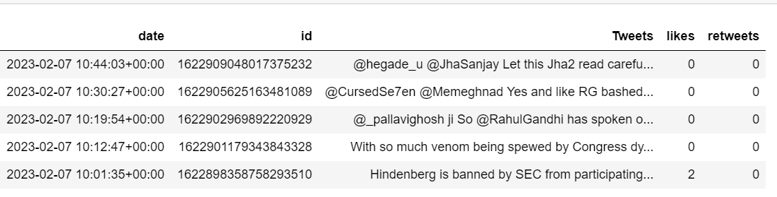
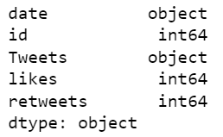
Dataset consists of 5 columns and 1000 rows
Each row represents a tweet by a user
Our area of interest are the tweets on which we will extract the sentiment

Slide 7

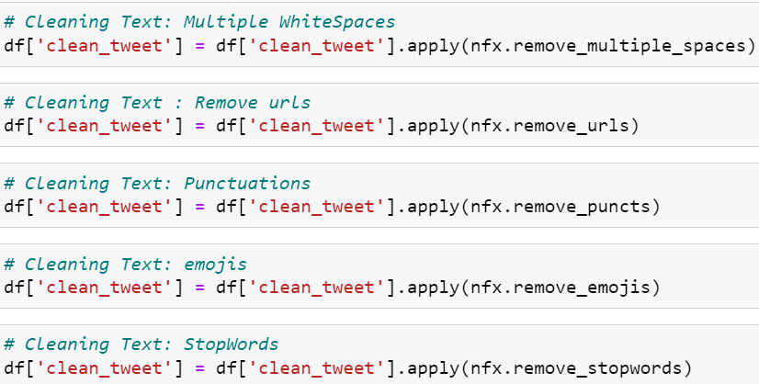
Data Pre-processing/Text Cleaning
The data or the tweet is in basic human language and consists of emojis, punctuation marks, hashtags etc. which needs to be taken care of before we can extract features/Keywords from them
We have used Neat text library to clean the data
Neat Text is a simple Natural Language Processing package for cleaning text data and pre-processing text data. It can be used to clean sentences, extract emails, phone numbers, weblinks, and emojis from sentences

Slide 8
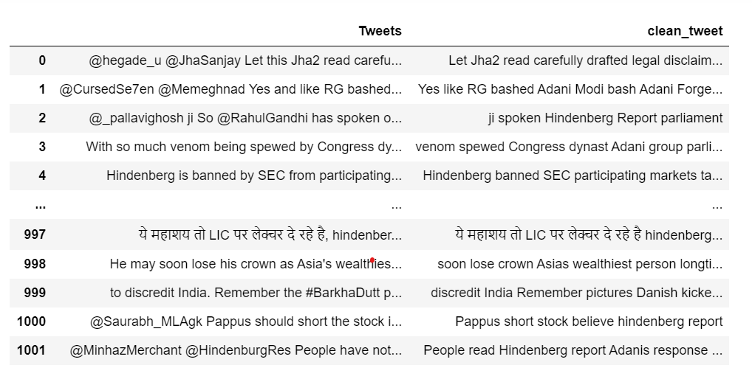
Tweets before cleaning and after cleaning

Slide 9
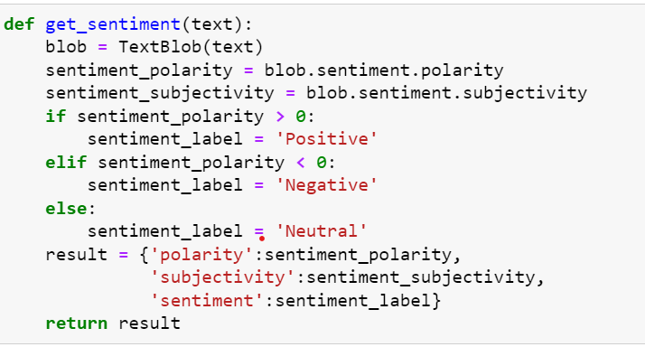
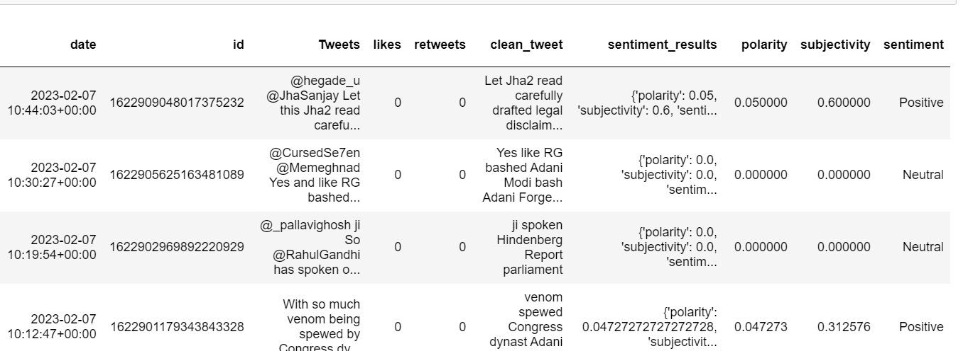
We have text bolb library for processing the tweets and get the sentiment
TextBlob is a Python (2 and 3) library for processing textual data. It provides a simple API for diving into common natural language processing (NLP) tasks such as part-of-speech tagging, noun phrase extraction, sentiment analysis, classification, translation, and more.
If the polarity is greater than 0 then it is termed as positive tweet, if it is less than 0 then its is a negative tweet and if it is equal to zero than it is neutral tweet

Slide 10
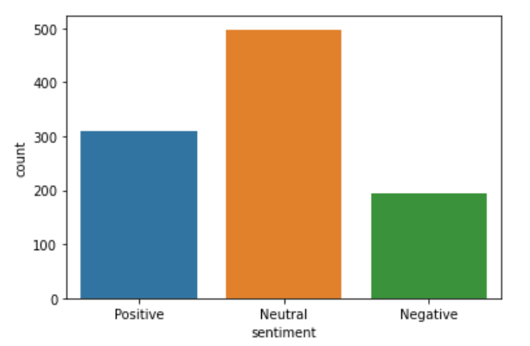
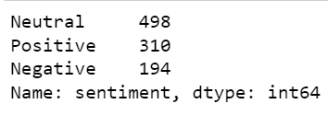
As can be see from the graph there are 310 positive tweets, 194 negative tweets and around 498 neutral tweets
Plot : 1

Slide 11
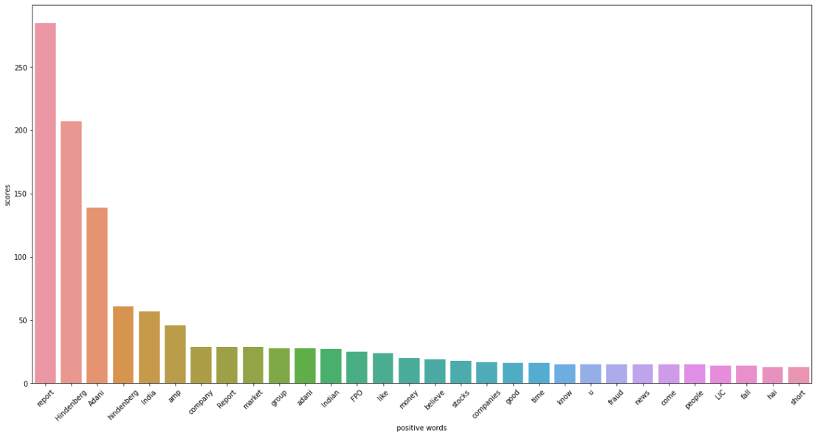
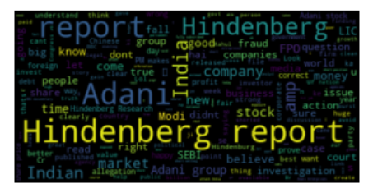
Keyword Extraction
Positive words word web
Plot : 2
Top positive keywords

Slide 12
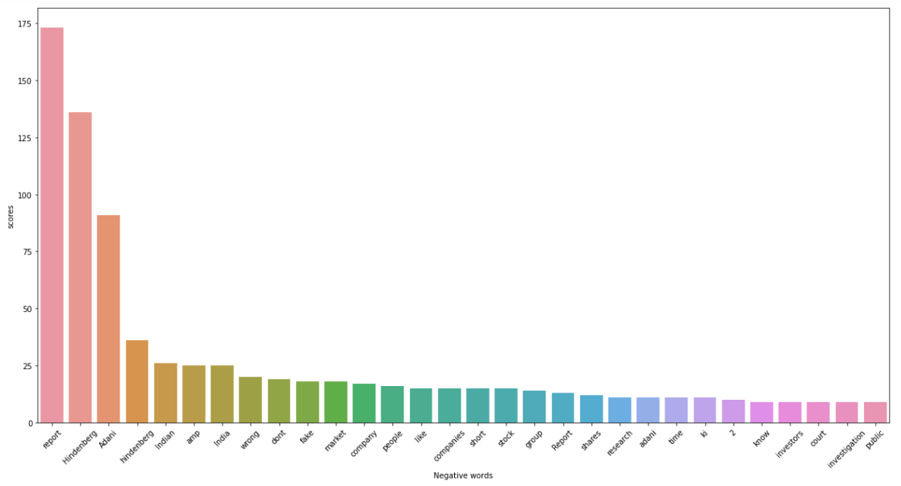
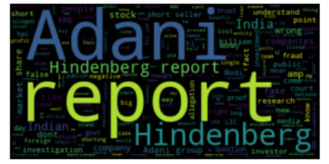
Negative words word web
Plot : 3
Top Negative keywords

Slide 13
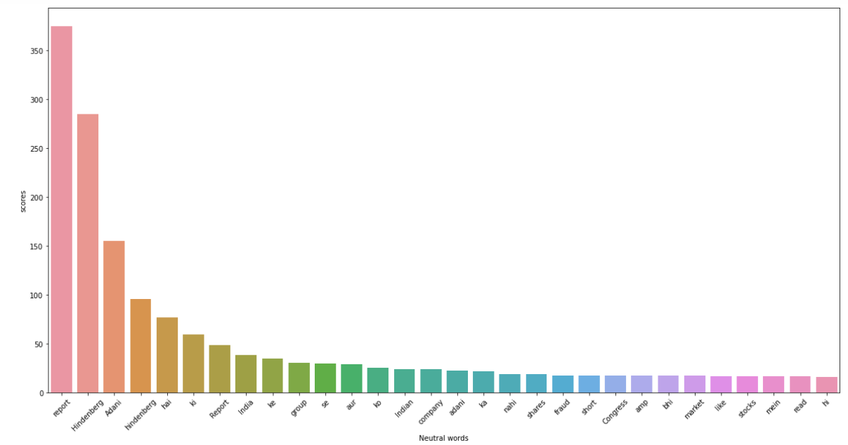
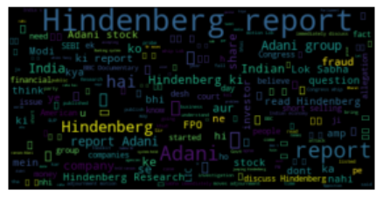
Neutral words word web
Plot : 5
Top Neutral keywords

Slide 14
Data modeling
This stage involves training a Deep learning model to make predictions about the sentiment of the the tweet
It is a binary classification problem
The aim of building the model is to predict if the tweet is negative or positive
Evaluation metrics used here is the accuracy
We have used two Deep Learning models to train our model
Simple Neural Network
Recurrent Neural Network(LSTM)

Slide 15
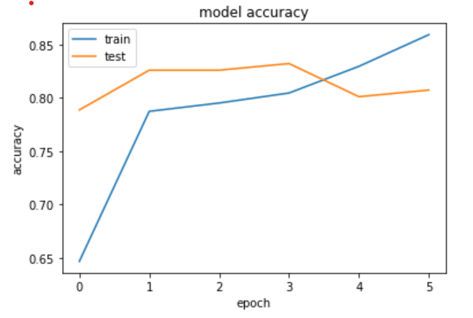
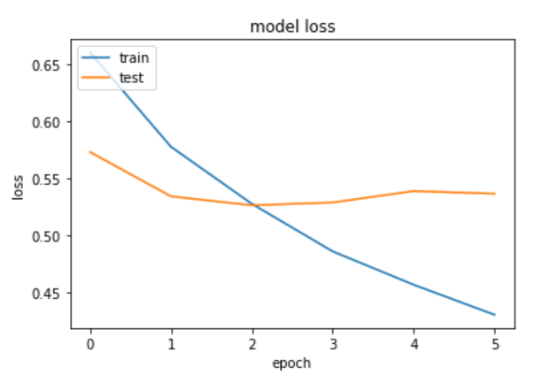
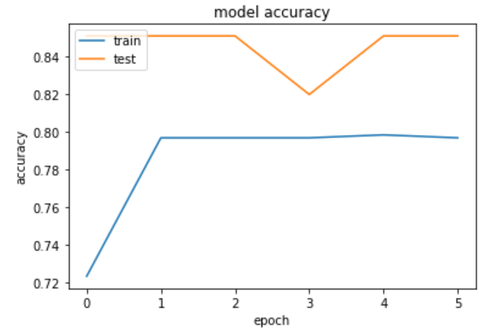
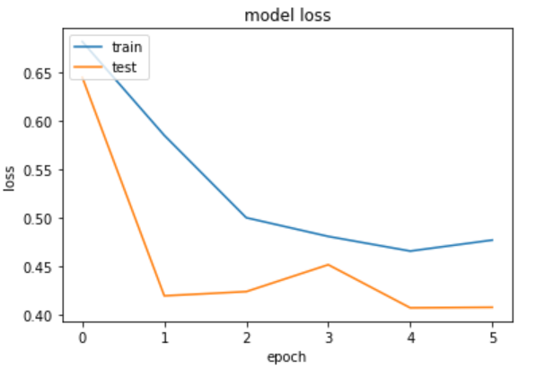
Simple Neural Netwoel
Recurrent Neural Network(LSTM

Slide 16
How Useful ?
Adani is a large conglomerate with operations in various sectors, so sentiment analysis could be used to track public perception and sentiment towards Adani as a company, or towards specific projects or initiatives that Adani is involved in.
sentiment analysis could be used to monitor social media and news outlets for mentions of Adani and gauge whether the sentiment expressed is positive, negative, or neutral. This information could then be used by Adani to make informed decisions about their branding, marketing strategies, and public relations efforts.

Slide 17
CONCLUSION
From our analysis we could see that there were all there i.e., positive, negative and neutral tweets with majority of them being neutral followed by positive tweets
Hence we can conclude the overall the reaction of the public towards the Adani-Hindenburg row was positive
Way Forword
The dataset consisted of only 1000 tweets which is very less if you are trying to build a deep learning model
It's important to note that sentiment analysis is not always accurate or comprehensive, and there can be significant biases and limitations in the data and analysis. There is a scope of additional research and analysis

Slide 18


